Slide 1
CAP777: WEB DEVELOPMMENT USING PHP Lecture Zero
Amandeep Kaur
Assistant Professor
School of Computer Applications
Lovely Professional University

Slide 2
Course Details
L=3, T=0, P=2 Credits 4.0
Examinations:
4 Continuous Assessments 3rd week (Lab Evaluation 1) 6th week (Lab Evaluation 2), 9th week (Mini Project Evaluation) and 12th week (Mini Project Evaluation).
End Term Practical will be held after week 14.

Slide 3
Course Outcomes
CO1 :: Knowledge about dynamic web based solutions development.
CO2 :: Understand essentials skills for commercial web development.
CO3 :: Employ the mandatory skills of web based IT solution development.
CO4 :: Explore the possibility to come up with optimized web based IT solution.

Slide 4
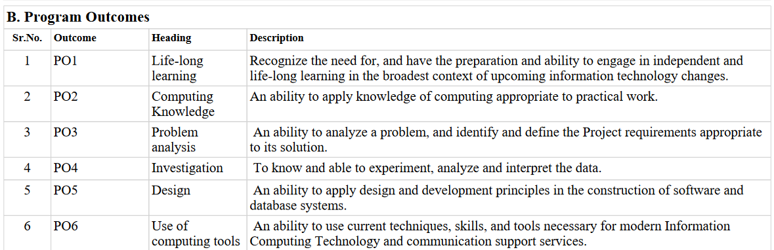

Slide 5
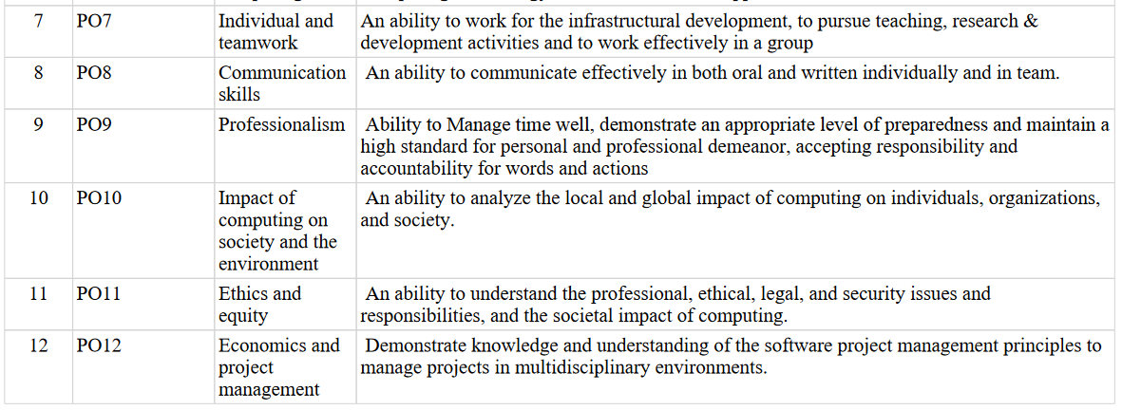

Slide 6
Course Content (Syllabus)
Unit I
Basics of PHP : introduction to PHP, client site script vs server site script, compiling process for php web page, variables in PHP, constants in PHP, control flow statements, looping statements, OOPs in PHP
Unit II
Functions in PHP : built in functions in php, defining and calling user defined functions in PHP, function parameters in php Arrays in PHP : types of arrays supported in php, performing operations on array in PHP, traversing arrays in php, sorting arrays in php, array functions in PHP.
Unit III
Handling HTML forms with PHP : html form controls, capturing HTML form data using PHP, sending data from PHP to HTML page

Slide 7
Unit IV
Database using MYSQLi with PHP : database options using php, performing database operations using mysqli, performing database navigation using mysqli, using grid with mysqi
Unit V
Introduction to Laravel Framework : configuring laravel framework, html template to laravel blade template, database migrations, database eloquent ORM (CRUD)
Unit VI
Advanced Laravel features : form validations in laravel, file storage and uploading in laravel, database seeding in laravel, sending emails using laravel, git and git hub (version control) for laravel

Slide 8
List of Practical's / Experiments
Programming in PHP • logic implementation using different types of variables • programing constructs in PHP • using objects of classes to implement properties and methods
Implementing functions in PHP • creating functions in PHP • types of function calls in PHP • functions arguments in PHP Implementing arrays in PHP • indexed arrays in PHP • associative arrays in PHP • multidimensional arrays in PHP

Slide 9
List of Practical's / Experiments
HTML forms and PHP • applying logic on html form data using PHP. • methods to send to data from html to PHP page.
Using MYSQLi database • sending data from html page to MYSQLi database using php • different modes to retrieve data from a MYSQLi database to HTML page.
Working with Laravel framework • migrating from HTML to Laravel • CRUD operations on MYSQLi database • implementing validations using Laravel • managing Laravel versions using Git Hub

Slide 10
Evaluation Criteria
Assessment Criteria | Weightage
Attendance | 5
Continuous Assessments | 25
MTT (Objective) | 20
End Term Exam | 25
ETP | 25
Total | 100

Slide 11
Text Book
Text Books:
PROGRAMMING PHP by RASMUS LERDORF, KEVIN TATROE, O'REILL
References:
WEB TECHNOLOGIES BLACK BOOK by KOGENT LEARNING SOLUTIONS INC., DREAMTECH PRESS
WEB TECHNOLOGIES HTML, CSS3, JAVASCRIPT, JQUERY, AJAX, PHP, XML, MVC AND LARAVEL by DT EDITORIAL SERVICES, DREAMTECH PRES

Slide 12
MOOCs
Introduction to Web Designing (HTML/ CSS/ REACT)
https://www.coursera.org/specializations/web-design
Introduction to Laravel Framework
https://www.linkedin.com/learning/advanced-laravel
Professional Web Development using PHP
https://www.coursera.org/learn/web-applications-php
https://www.coursera.org/learn/database-applications-php

Slide 13
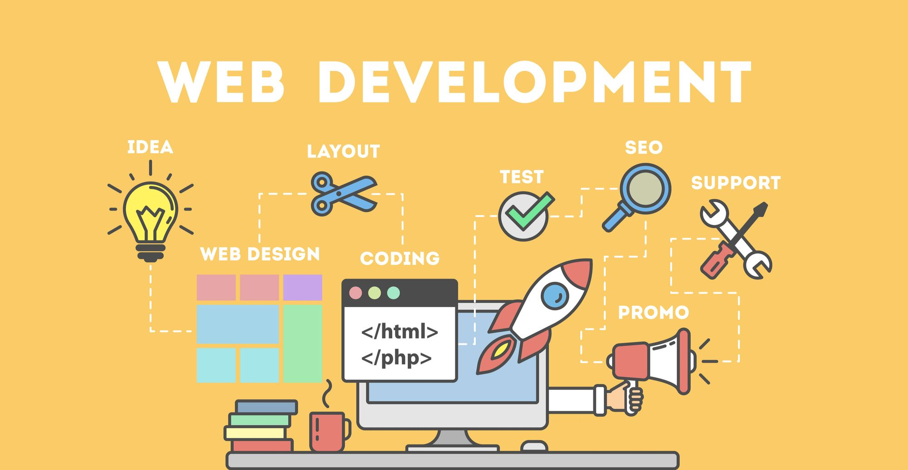
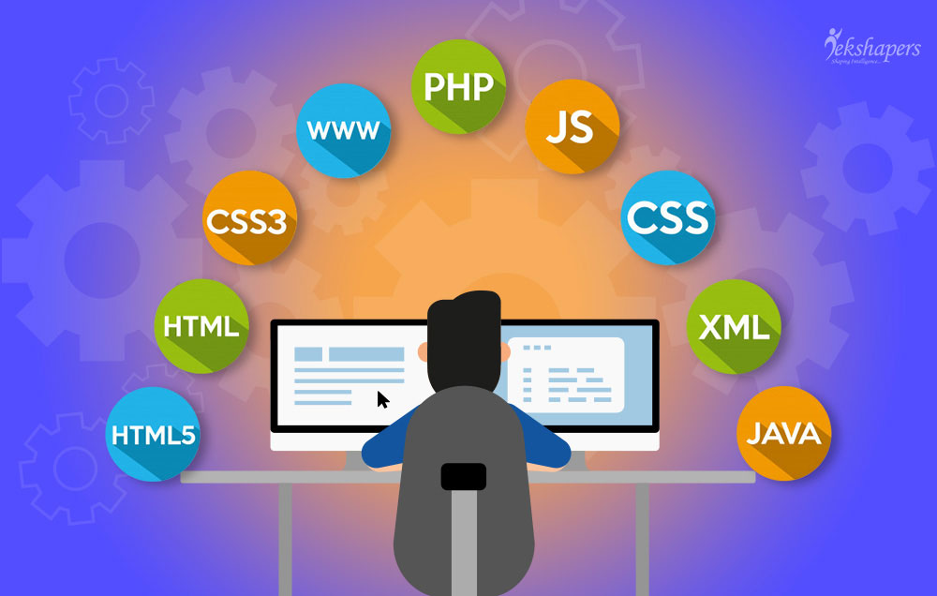
What can Web Programming do?

Slide 14
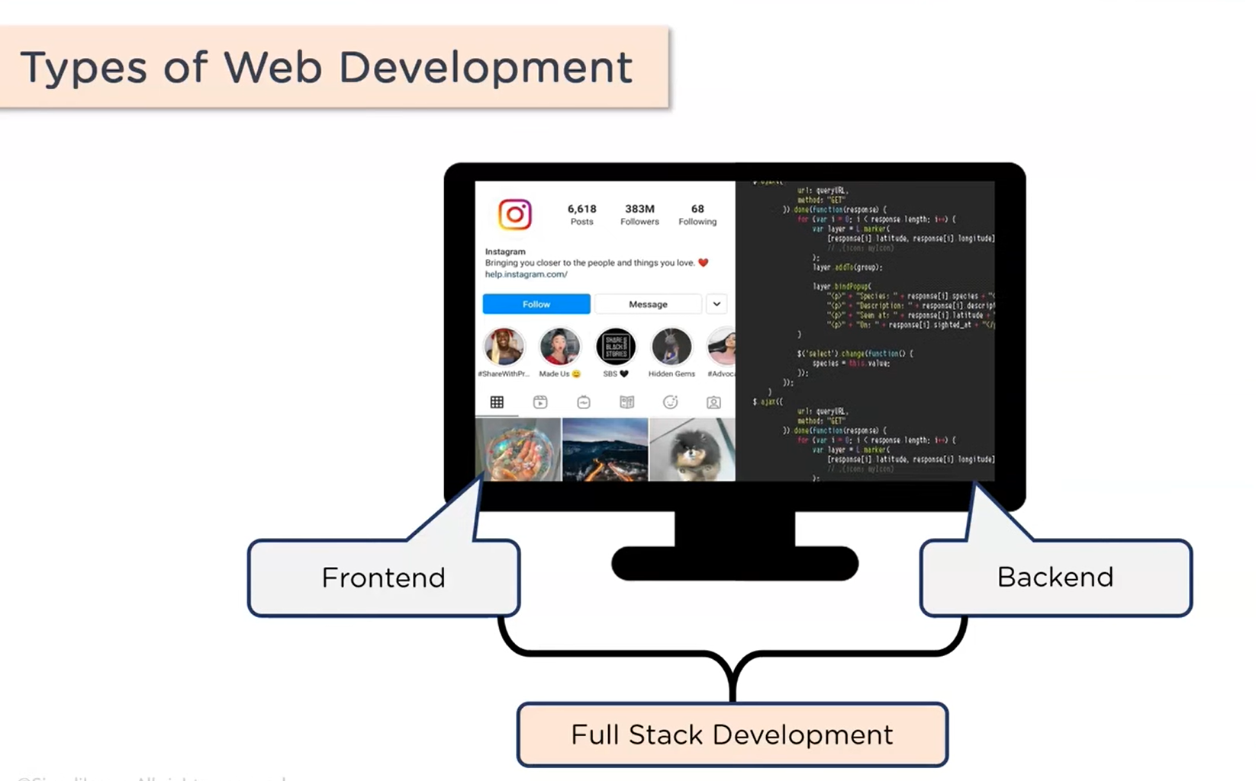

Slide 15
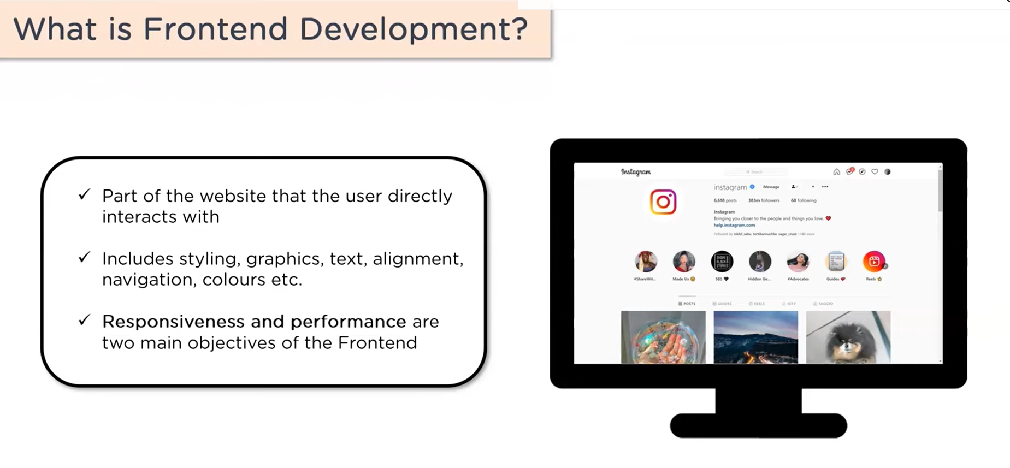

Slide 16
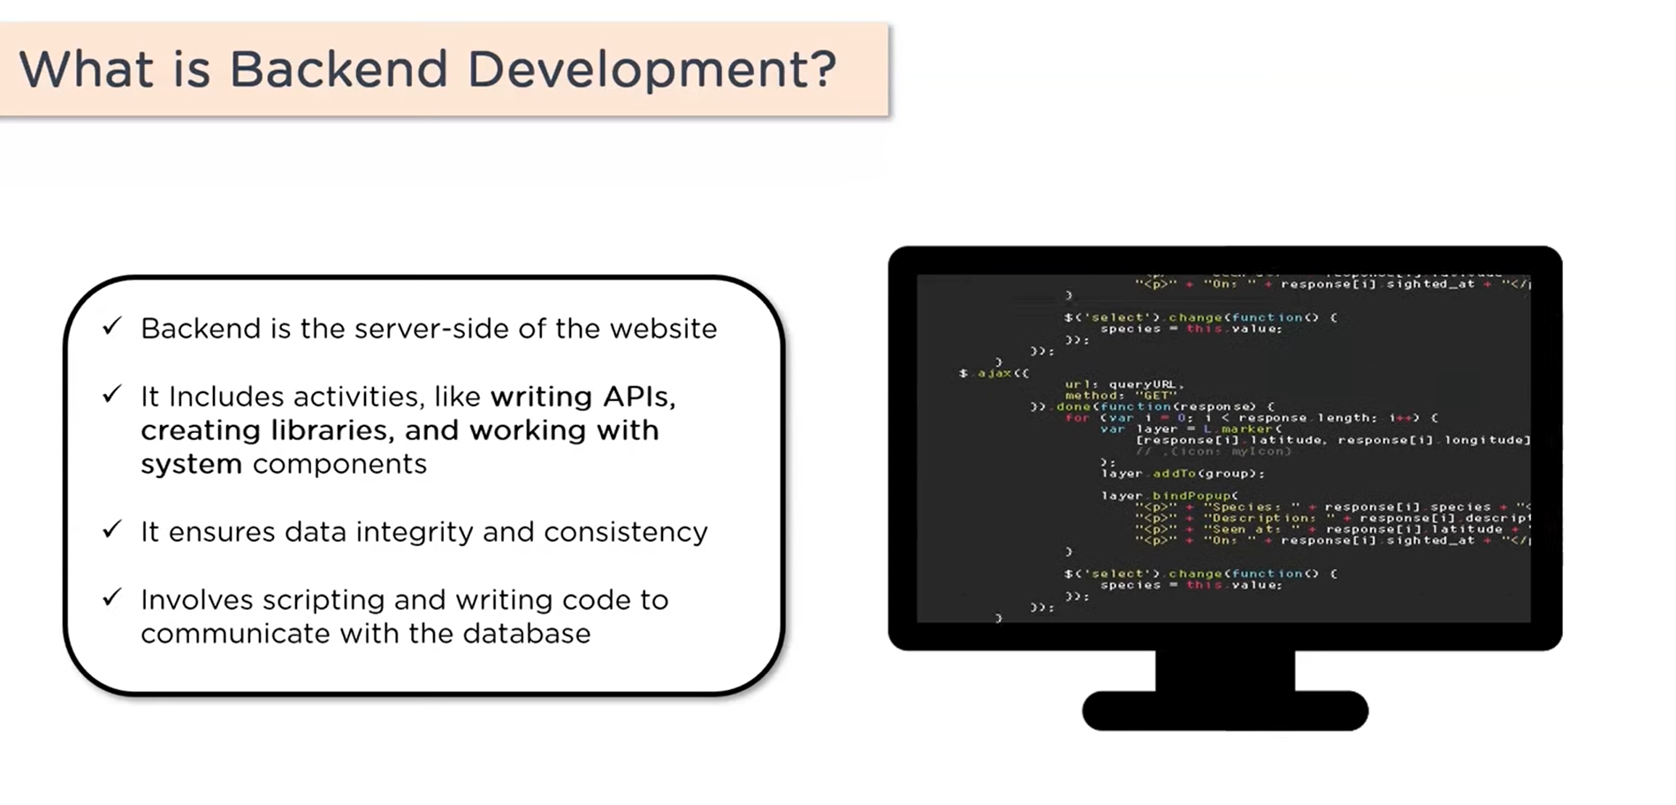

Slide 17
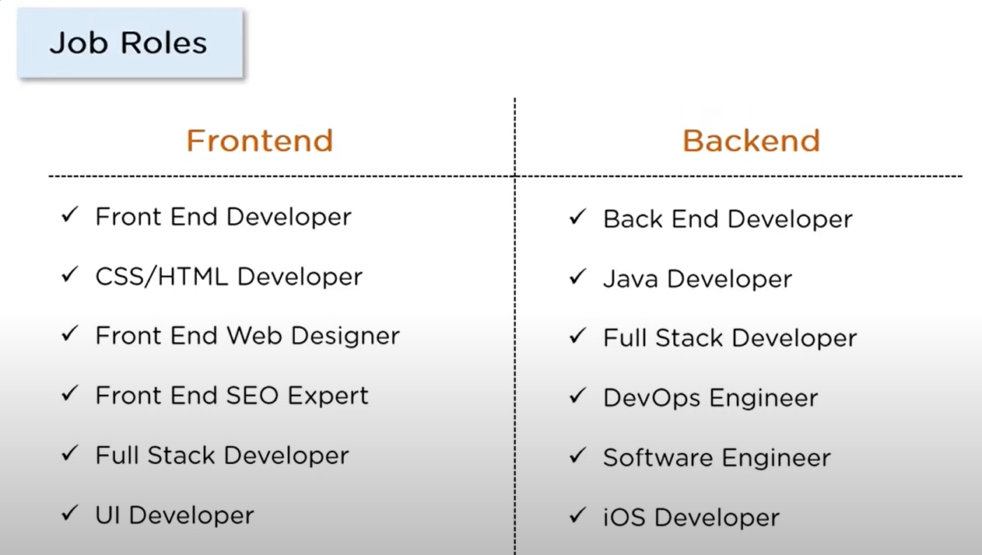

Slide 18
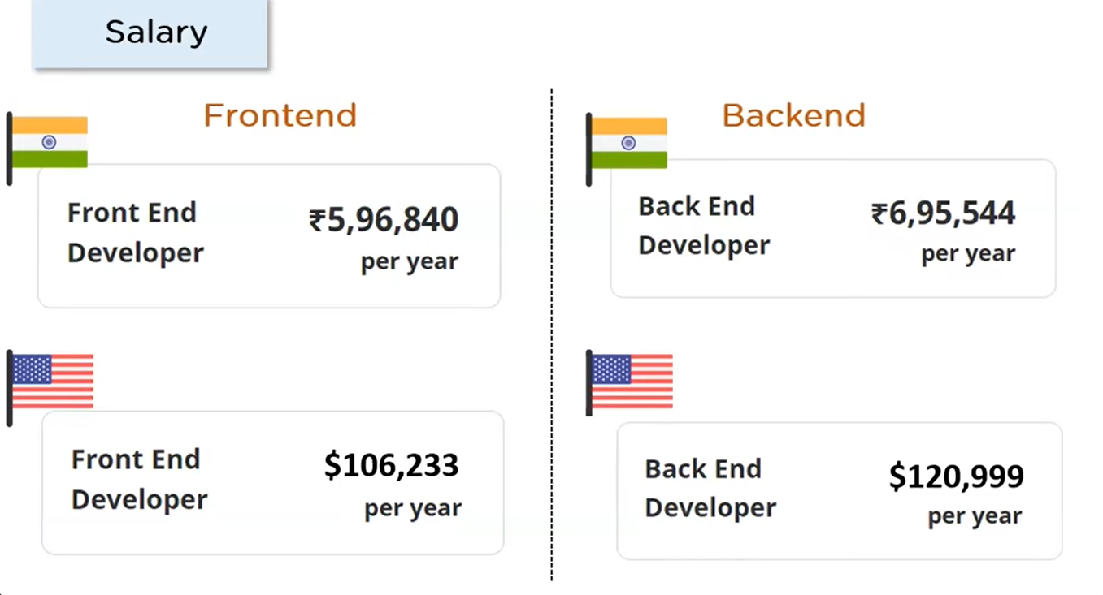

Slide 19
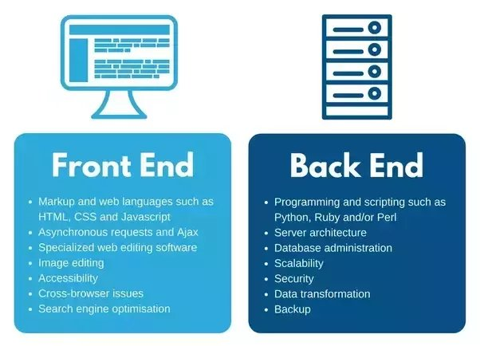
Front End and Back End

Slide 20
PHP Developer Requirements
Knowledge of PHP web frameworks including Yii, Laravel, and CodeIgniter.
Knowledge of front-end technologies including CSS3, JavaScript, and HTML5.
Understanding of object-oriented PHP programming.
Previous experience creating scalable applications.
Proficient with code versioning tools including Git, Mercurial, CVS.
Familiarity with SQL/NoSQL/ MYSQLi databases.
Ability to manage a project.
Good problem-solving skills.

